Slide 1
Don’t take on C++ programmers support
+
+
+
+
+
Yuri Minaev
+
+

Slide 2
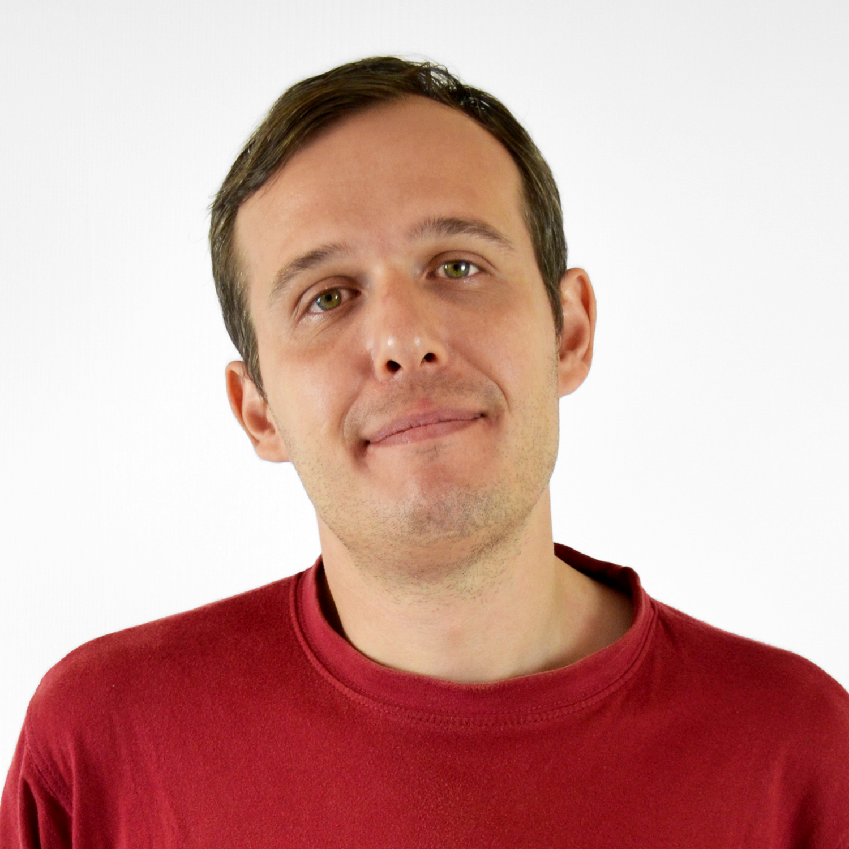
About me
Yuri Minaev
C++ developer at PVS-Studio
minaev@viva64.com
01
CoreHard

Slide 3
What is this all about?
– Doctor, am I gonna live?
– And what’s the point?
Joke
Tech support for professional C++ developers
Funny cases we occasionally get
Why so serious?
02
CoreHard

Slide 4
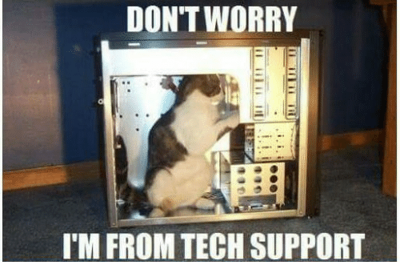
On tech support
03
CoreHard

Slide 5
On tech support
Programmers typically know what they want...
...and often can understand what the problem is
It’s a pleasure to talk to a smart person
04
CoreHard

Slide 6
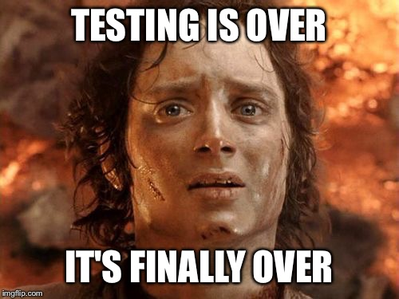
9 circles of testing
We test:
A lot
Often
In various ways
05
CoreHard

Slide 7
9 circles of testing
Documentation tests
UI tests
Unit tests
Diagnostic tests
Runs against an array of real projects
Dynamic analysis
Static analysis
Compilation monitor tests
Docker tests
06
CoreHard

Slide 8
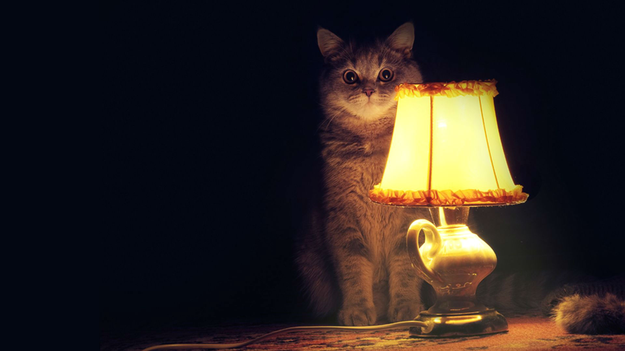
Story time
CoreHard
07

Slide 9
Don’t trust standard functions
bool set_value_convert(char_t *&dest, ....,
int value)
{
char buf[128];
sprintf(buf, "%d", value);
return set_value_buffer(...., buf);
}
V614 Uninitialized buffer 'buf' used.
08
CoreHard

Slide 10
Don’t trust standard functions
bool set_value_convert(char_t *&dest, ....,
int value)
{
char buf[128];
sprintf(buf, "%d", value);
return set_value_buffer(...., buf);
}
V614 Uninitialized buffer 'buf' used.
CoreHard
09

Slide 11
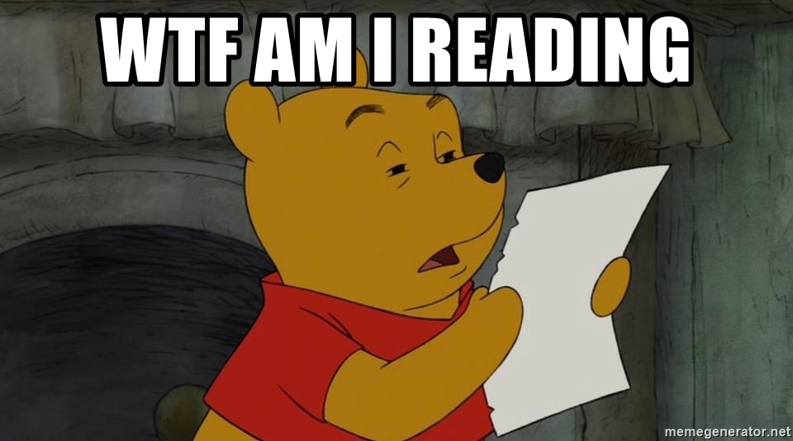
Don’t trust standard functions
10
CoreHard

Slide 12
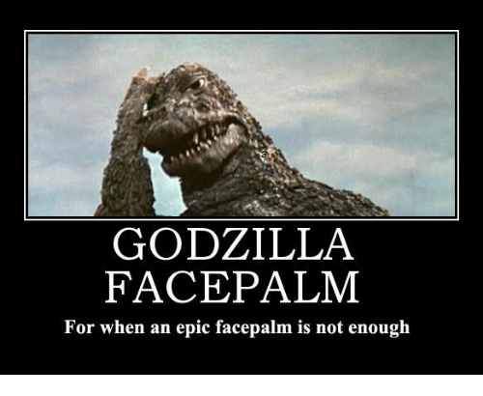
Don’t trust standard functions
#define schar char
#define suchar unsigned schar
#define sprintf std::printf
#define satof atof
#define satoi atoi
11
CoreHard

Slide 13
More on standard functions
static int EatWhitespace(FILE* InFile)
{
int c;
for (c = getc(InFile); isspace(c) && ('\n' != c);
c = getc(InFile));
return (c);
}
V560 A part of conditional expression is always true: ('\n' != c).
12
CoreHard

Slide 14
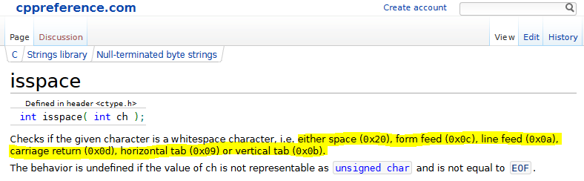
More on standard functions
13
CoreHard

Slide 15
More on standard functions
#define isspace(c) ((c)==' ' || (c) == '\t')
static int EatWhitespace(FILE* InFile)
{
int c;
for (c = getc(InFile);
((c)==' ' || (c) == '\t') && ('\n' != c);
c = getc(InFile));
return (c);
}
14
CoreHard

Slide 16
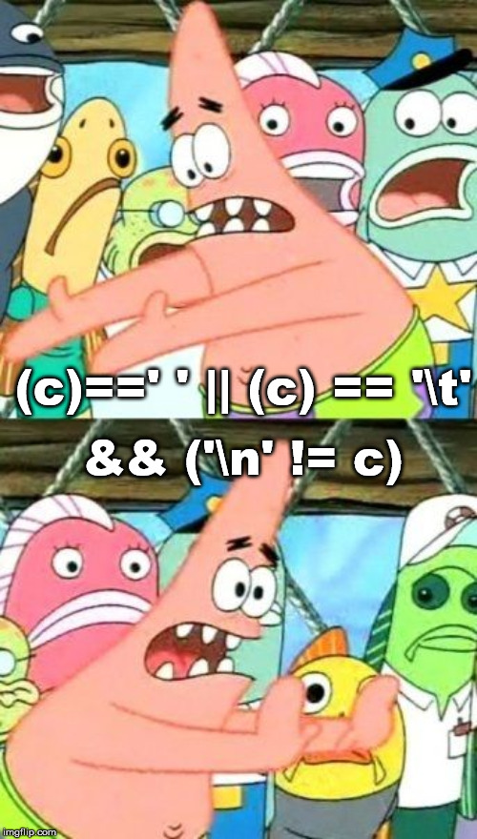
More on standard functions
for (c = getc(InFile);
((c)==' ' || (c) == '\t')
&& ('\n' != c);
c = getc(InFile));
15
CoreHard

Slide 17
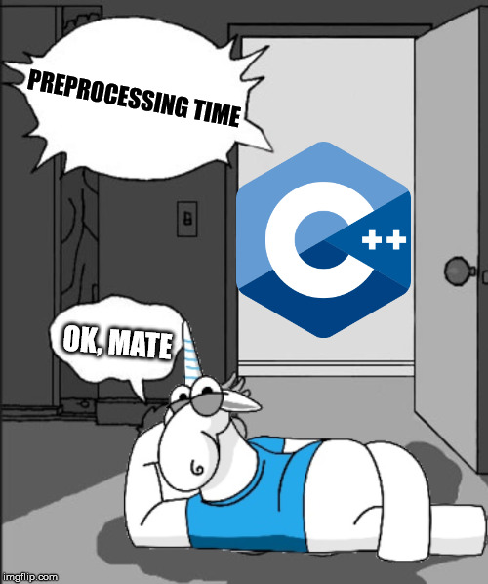
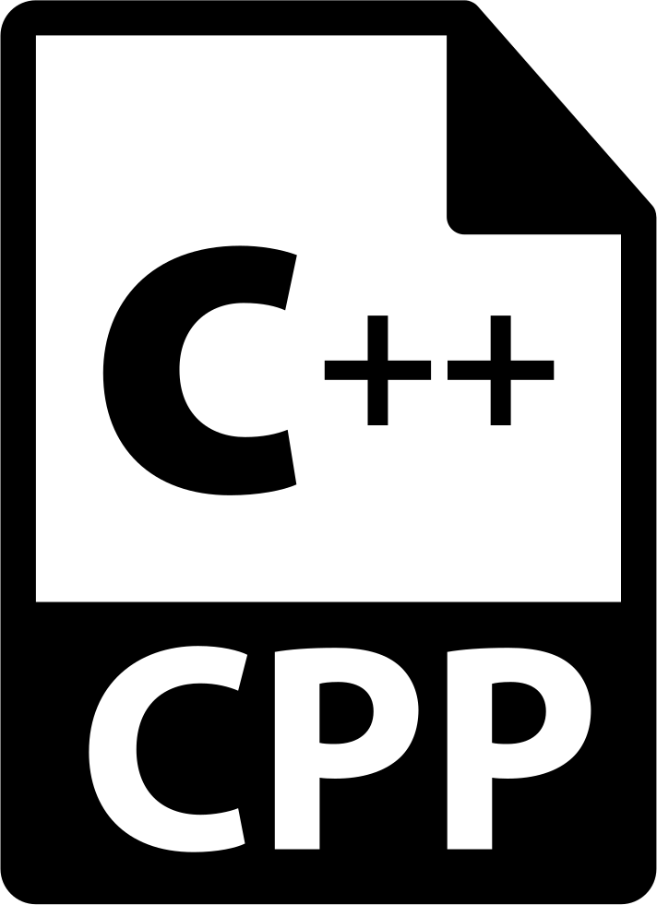
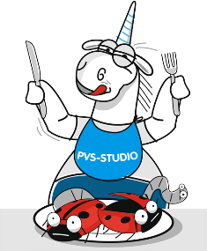
Preprocessor fairy tales
CoreHard
16

Slide 18
Preprocessor fairy tales
void f()
{
#line 42 "somefile.abc"
int a = 10 / 0;
}
17
CoreHard

Slide 19
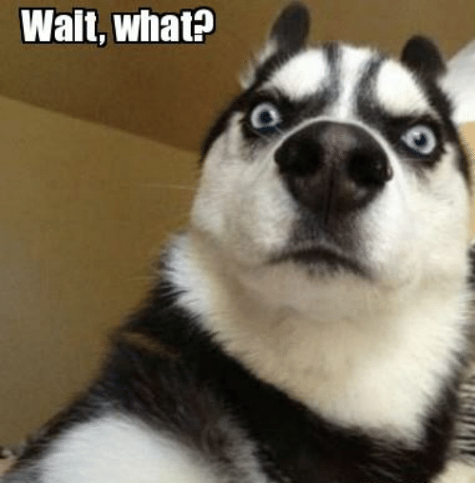
Preprocessor fairy tales
#line 1 "D:\\Demo\\Source.cpp"
void f()
{
#line 42 "D:\\Demo\\somefile.abc"
int a = 10 / 0;
}
18
CoreHard

Slide 20
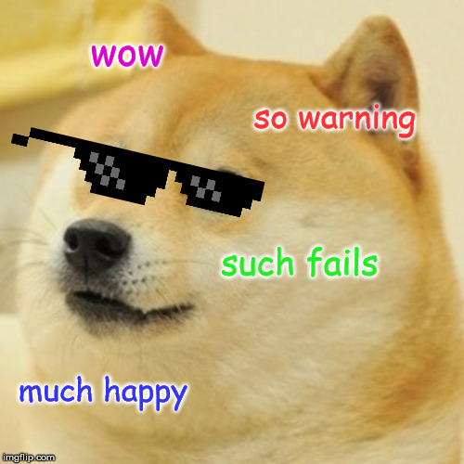
Preprocessor fairy tales
19
CoreHard

Slide 21
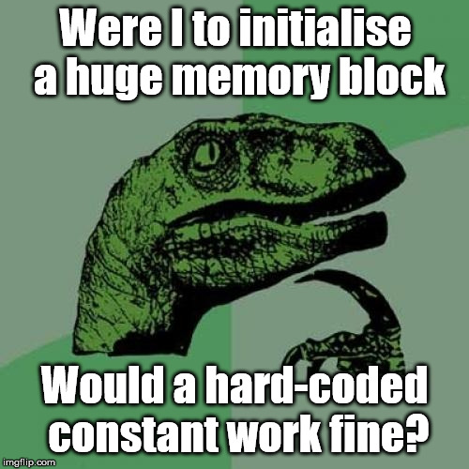
26mb ought to be enough for anybody
20
CoreHard

Slide 22
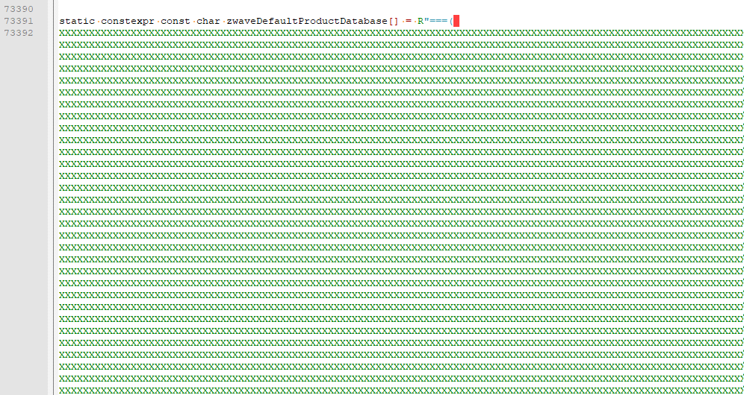
26mb ought to be enough for anybody
21
CoreHard

Slide 23
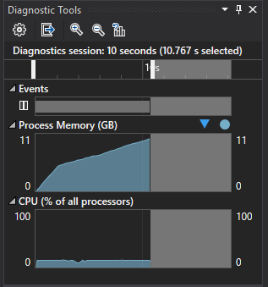
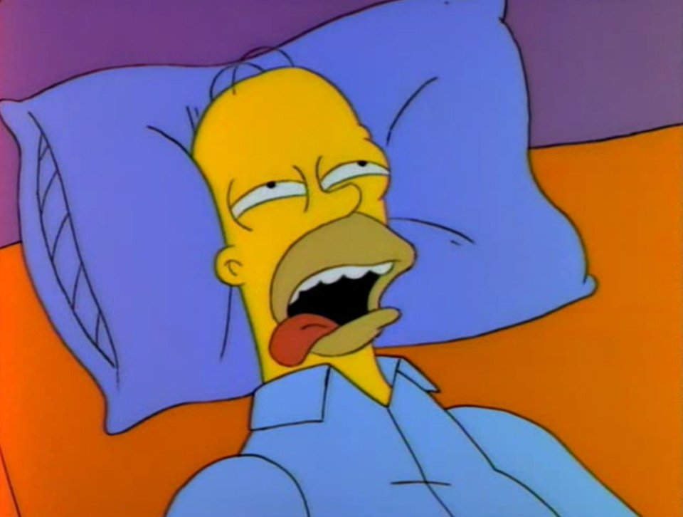
26mb ought to be enough for anybody
22
CoreHard

Slide 24
On logics
if (ch >= 0x0FF00)
{
if (!((ch >= 0x0FF10) && (ch <= 0x0FF19)) ||
((ch >= 0x0FF21) && (ch <= 0x0FF3A)) ||
((ch >= 0x0FF41) && (ch <= 0x0FF5A)))
{
//....
}
}
V560 A part of conditional expression is always false: (ch >= 0x0FF21)
V560 A part of conditional expression is always true: (ch <= 0x0FF3A)
V560 A part of conditional expression is always false: (ch >= 0x0FF41)
V560 A part of conditional expression is always true: (ch <= 0x0FF5A)
23
CoreHard

Slide 25
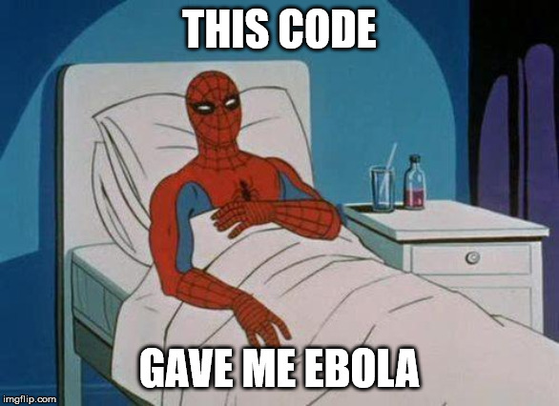
On logics
24
CoreHard

Slide 26
On logics
if (ch >= 0x0FF00)
{
if (!((ch >= 0x0FF10) && (ch <= 0x0FF19)) ||
((ch >= 0x0FF21) && (ch <= 0x0FF3A)) ||
((ch >= 0x0FF41) && (ch <= 0x0FF5A)))
{
//....
}
}
V560 A part of conditional expression is always false: (ch >= 0x0FF21)
V560 A part of conditional expression is always true: (ch <= 0x0FF3A)
V560 A part of conditional expression is always false: (ch >= 0x0FF41)
V560 A part of conditional expression is always true: (ch <= 0x0FF5A)
25
CoreHard

Slide 27
On logics
!(
((ch >= 0x0FF10) && (ch <= 0x0FF19)) ||
((ch >= 0x0FF21) && (ch <= 0x0FF3A)) ||
((ch >= 0x0FF41) && (ch <= 0x0FF5A))
)
26
CoreHard

Slide 28
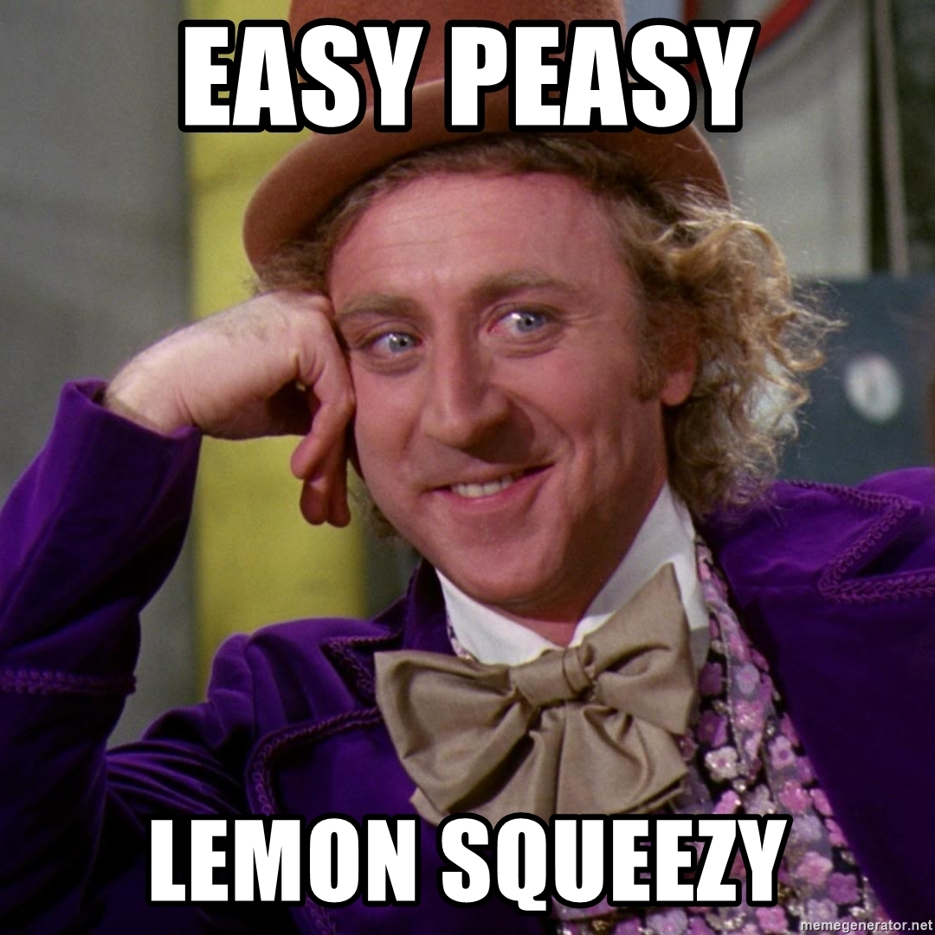
Initialisation is easy
class Vector
{
public:
int x, y, z;
Vector()
{
x = 0;
y = 0;
}
};
27
CoreHard

Slide 29
Initialisation is easy
28
CoreHard

Slide 30
Initialisation is easy
29
CoreHard

Slide 31
Initialisation is easy
30
CoreHard

Slide 32
When robots get tired
Advantages of static analysis over code review:
Cheap
Analysers don’t get tired (unlike humans)
Analysers know error patterns unknown to developers
31
CoreHard

Slide 33
When robots get tired
Advantages of static analysis over code review:
Cheap
Analysers don’t get tired (unlike humans)
Analysers know error patterns unknown to developers
32
CoreHard

Slide 34
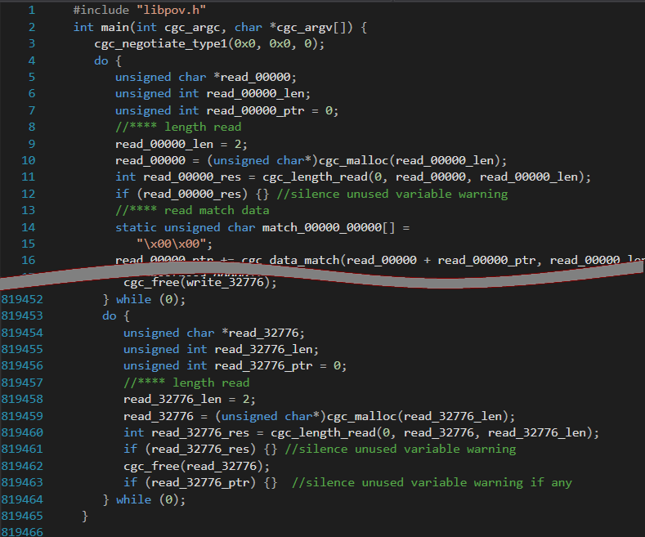
When robots get tired
819466
33
CoreHard

Slide 35
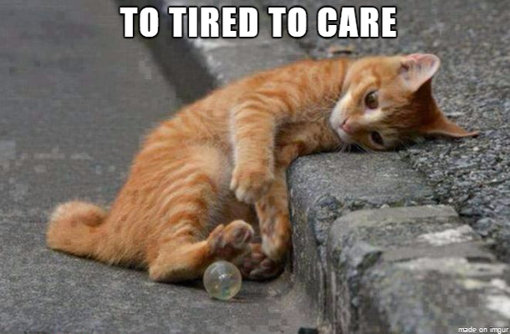
When robots get tired
CoreHard
34

Slide 36
Detour
Real heroes never take straight paths
35
CoreHard

Slide 37
Detour
int f()
{
#include "Header.h"
return a;
}
36
CoreHard

Slide 38
Detour
static wchar_t* getSectionName(int flag)
{
switch (flag)
{
#include "finger_groups.h"
}
return NULL;
}
37
CoreHard

Slide 39
WinAPI is fun
Go ask Wine developers
38
CoreHard

Slide 40
WinAPI is fun
#include <windows.h>
#include <aclapi.h>
#include <tchar.h>
int main()
{
PACL pDACL = NULL;
PSECURITY_DESCRIPTOR pSD = NULL;
::GetNamedSecurityInfo(_T("ObjectName"), SE_FILE_OBJECT,
DACL_SECURITY_INFORMATION, NULL, NULL, &pDACL, NULL, &pSD);
auto test = pDACL == NULL;
return 0;
}
V547 Expression 'pDACL == 0' is always true.
39
CoreHard

Slide 41
WinAPI is fun
#include <windows.h>
#include <aclapi.h>
#include <tchar.h>
int main()
{
PACL pDACL = NULL;
PSECURITY_DESCRIPTOR pSD = NULL;
::GetNamedSecurityInfo(_T("ObjectName"), SE_FILE_OBJECT,
DACL_SECURITY_INFORMATION, NULL, NULL, &pDACL, NULL, &pSD);
auto test = pDACL == NULL;
return 0;
}
V547 Expression 'pDACL == 0' is always true.
40
CoreHard

Slide 42
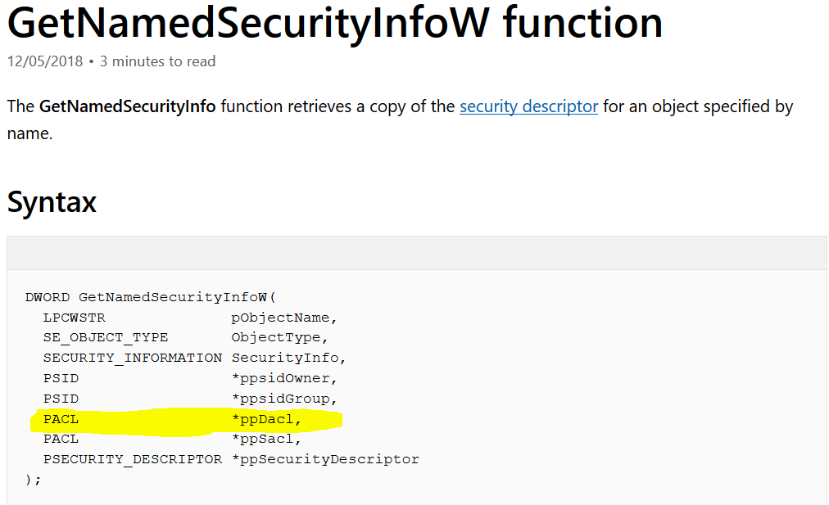
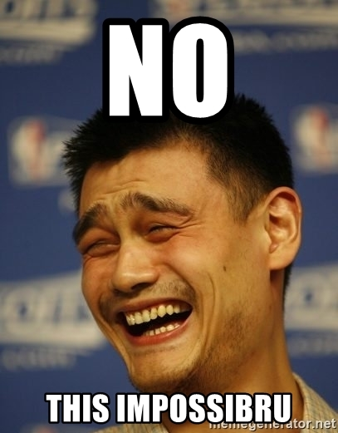
WinAPI is fun
41
CoreHard

Slide 43
WinAPI is fun
__declspec(dllimport)
DWORD
__stdcall
GetNamedSecurityInfoW(
LPCWSTR pObjectName,
SE_OBJECT_TYPE ObjectType,
SECURITY_INFORMATION SecurityInfo,
const PSID* ppsidOwner,
const PSID* ppsidGroup,
const PACL* ppDacl,
const PACL* ppSacl,
PSECURITY_DESCRIPTOR* ppSecurityDescriptor
);
42
CoreHard

Slide 44
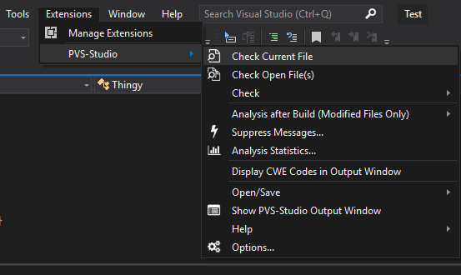
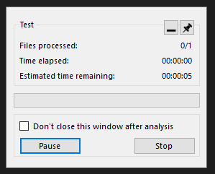
The scariest bug
43
CoreHard

Slide 45
The scariest bug
44
CoreHard

Slide 46
The scariest bug
45
CoreHard

Slide 47
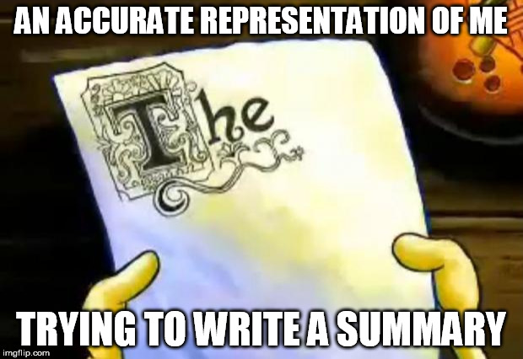
Takeaway
Tests are awesome
But humans are inventive
We love our users and want to help them
But don’t take on C++ programmers support
46
CoreHard

Slide 48
+
+
+
+
Q&A
+
+
+
+
Yuri Minaev – minaev@viva64.com

